Slide 1
Introduction to Java for C++ Programmers
Segment 1 – AWT (Abstract Window Toolkit)
Professor: Mahboob Ali

Slide 2
There are two sets of Java APIs for graphics programming:
AWT API (Abstract Window Toolkit)
Swings API

Slide 3
AWT
Java AWT (Abstract Window Toolkit) is an API to develop GUI or window-based applications in java.
Java AWT components are platform-dependent.
AWT is heavyweight i.e. its components are using the resources of OS.

Slide 4
java.awt package
contains:
GUI Component classes like - Button, TextField and Label.
GUI Container classes like – Frame and Panel
Layout managers like – FlowLayout, BorderLayout and GridLayout
Custom graphics classes like – Graphics, Color and Fonts

Slide 5
java.awt.event package
contains:
Event classes like – ActionEvent, MouseEvent, WindowEvent …
Event Listener Interfaces like – ActionListener, MouseListener, WindowListener …
Event Listener Adapter classes like – MouseAdapter, WindowAdapter …

Slide 6
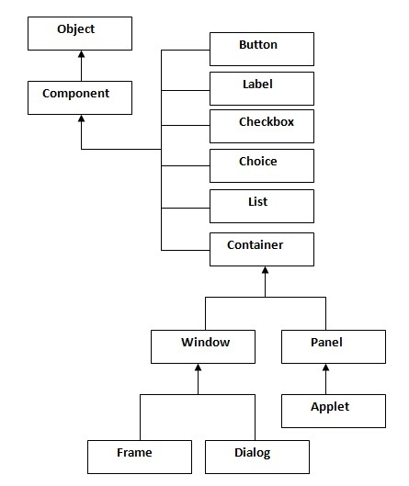
AWT Hierarchy

Slide 7
Container: a component in AWT that can contain another components like buttons, textfields, labels etc. The classes that extends Container class are known as container such as Frame, Dialog and Panel.
Window: is the container that have no borders and menu bars. You must use frame, dialog or another window for creating a window.
Panel: is the container that doesn't contain title bar and menu bars. It can have other components like button, textfield etc.
Frame: is the container that contain title bar and can have menu bars. It can have other components like button, textfield etc.

Slide 8
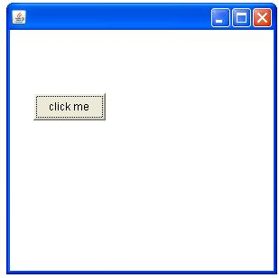
AWT Example: Extending Frame Class
import java.awt.*;
class First extends Frame{
First(){
Button b=new Button("click me");
b.setBounds(30,100,80,30);// setting button position
add(b); //adding button into frame
setSize(300,300); //frame size 300 width and 300 height
setLayout(null); //By default BorderLayout
setVisible(true); //By default not visible
}
public static void main(String args[]){
First f=new First();
}
}

Slide 9
AWT Example: Creating Instance of Frame
import java.awt.*;
class First2{
First2(){
Frame f=new Frame();
Button b=new Button("click me");
b.setBounds(30,50,80,30);
f.add(b);
f.setSize(300,300);
f.setLayout(null);
f.setVisible(true);
}
public static void main(String args[]){
First2 f=new First2();
}}

Slide 10
Event Handling
Changing the state of an object is known as an event. For example, click on button, dragging mouse etc.
…………
Event Classes | Listener Interfaces
ActionEvent | ActionListener
MouseEvent | MouseListener and MouseMotionListene
ItemEvent | ItemListener
TextEvent | TextListener

Slide 11
Performing Event Handling
Register the component with the Listener, for example
Button
public void addActionListener(ActionListener a){}
MenuItem
public void addActionListener(ActionListener a){}
TextField
public void addActionListener(ActionListener a){}
public void addTextListener(TextListener a){}
TextArea
public void addTextListener(TextListener a){}
Checkbox
public void addItemListener(ItemListener a){}
Choice
public void addItemListener(ItemListener a){}
List
public void addActionListener(ActionListener a){}
public void addItemListener(ItemListener a){}

Slide 12
By Implementing ActionListener
import java.awt.*;
import java.awt.event.*;
class AEvent extends Frame implements ActionListener{
TextField tf;
AEvent(){
//create components
tf=new TextField();
tf.setBounds(60,50,170,20);
Button b=new Button("click me");
b.setBounds(100,120,80,30);
//register listener
b.addActionListener(this);//passing current instance
//add components and set size, layout and visibility
add(b);add(tf);
setSize(300,300);
setLayout(null);
setVisible(true);
}
public void actionPerformed(ActionEvent e){
tf.setText("Welcome");
}
public static void main(String args[]){
new AEvent();
}
}
public void setBounds(int xaxis, int yaxis, int width, int height)

Slide 13
Event Handling By Outer Class
import java.awt.*;
import java.awt.event.*;
class AEvent2 extends Frame{
TextField tf;
AEvent2(){
//create components
tf=new TextField();
tf.setBounds(60,50,170,20);
Button b=new Button("click me");
b.setBounds(100,120,80,30);
//register listener
Outer o=new Outer(this);
//passing outer class instance
b.addActionListener(o);
//add components and set size, layout and visibility
add(b);add(tf);
setSize(300,300);
setLayout(null);
setVisible(true); }
public static void main(String args[]){
new AEvent2();
}
}
// Outer Class
import java.awt.event.*;
class Outer implements ActionListener{
AEvent2 obj;
Outer(AEvent2 obj){
this.obj=obj;
}
public void actionPerformed(ActionEvent e){
obj.tf.setText("welcome");
}
}

Slide 14
Checkbox Example with ItemListener
import java.awt.*;
import java.awt.event.*;
public class CheckboxExample
{
CheckboxExample(){
Frame f= new Frame("CheckBox Example");
final Label label = new Label();
label.setAlignment(Label.CENTER);
label.setSize(400,100);
Checkbox checkbox1 = new Checkbox("C++");
checkbox1.setBounds(100,100, 50,50);
Checkbox checkbox2 = new Checkbox("Java");
checkbox2.setBounds(100,150, 50,50);
f.add(checkbox1); f.add(checkbox2); f.add(label);
checkbox1.addItemListener(new ItemListener() {
public void itemStateChanged(ItemEvent e) {
label.setText("C++ Checkbox: "
+ (e.getStateChange()==1?"checked":"unchecked"));
}
});

Slide 15
checkbox2.addItemListener(new ItemListener() {
public void itemStateChanged(ItemEvent e) {
label.setText("Java Checkbox: "
+ (e.getStateChange()==1?"checked":"unchecked"));
}
});
f.setSize(400,400);
f.setLayout(null);
f.setVisible(true);
}
public static void main(String args[])
{
new CheckboxExample();
}
}

